Slide 1
Secure Data Hiding in Image Using Steganography
CAPSTONE PROJECT
Presented By:
Srishti Shil
Vidyasagar University
Department of Computer Science

Slide 2
OUTLINE
Problem Statement
Technology used
Wow factor
End users
Result
Conclusion
Git-hub Link
Future scope

Slide 3
Problem Statement
In the digital communication era, securing sensitive information is vital. Traditional encryption methods can be vulnerable, and textual messages are easily intercepted. This project uses Python-based image steganography to embed secret messages within pixel values, ensuring hidden communication while preserving the image's integrity. The decryption process is password-protected for additional security.

Slide 4
Technology used
Programming Language: Python
Libraries Used:
OpenCV (cv2): For image processing and pixel manipulation
os: For file handling and system operations
Concepts Implemented:
Image Steganography: Hiding text messages within image pixel values
Encryption & Decryption: Securely encoding and retrieving messages
ASCII Encoding: Converting characters into numeric values for embedding
File Handling: Storing passwords and message lengths for retrieval

Slide 5
Technology used
System Requirements:
Operating System: Windows, macOS, or Linux
Processor: Minimum Intel Core i3 or equivalent
RAM: At least 4GB (8GB recommended)
Storage: Minimum 500MB of free space
Python Version: Python 3.6 or later
Required Libraries: OpenCV (cv2), OS (pre-installed with Python)

Slide 6
Wow factors
Secure Message Hiding – Utilizes image steganography to conceal messages within pixel values, making it nearly impossible to detect.
Password-Protected Decryption – Only users with the correct passcode can retrieve the hidden message, adding an extra layer of security.
Minimal Data Alteration – Embeds text without significantly altering the image, ensuring visual integrity is maintained.
Cross-Platform Compatibility – Works on Windows, macOS, and Linux with minimal system requirements.
Efficient Encoding & Decoding – Uses optimized algorithms to store and extract messages efficiently from images.
Lightweight & Fast – Requires only basic Python libraries, making it quick to execute without heavy dependencies.

Slide 7
End users
Army & Defense Sector – Secure military communication by embedding classified messages within images to prevent interception by adversaries.
Banking & Financial Systems – Protects sensitive financial data, such as transaction details and account information, by embedding them securely in images to prevent fraud and unauthorized access.
Government Intelligence Agencies – Enables covert operations by allowing confidential data exchange without detection.
Cybersecurity in Banking – Can be used to securely transmit encryption keys or authentication data without raising suspicion.
Law Enforcement & Counter-Terrorism Units – Helps in safely exchanging mission-critical information without exposing it to cyber threats.

Slide 8
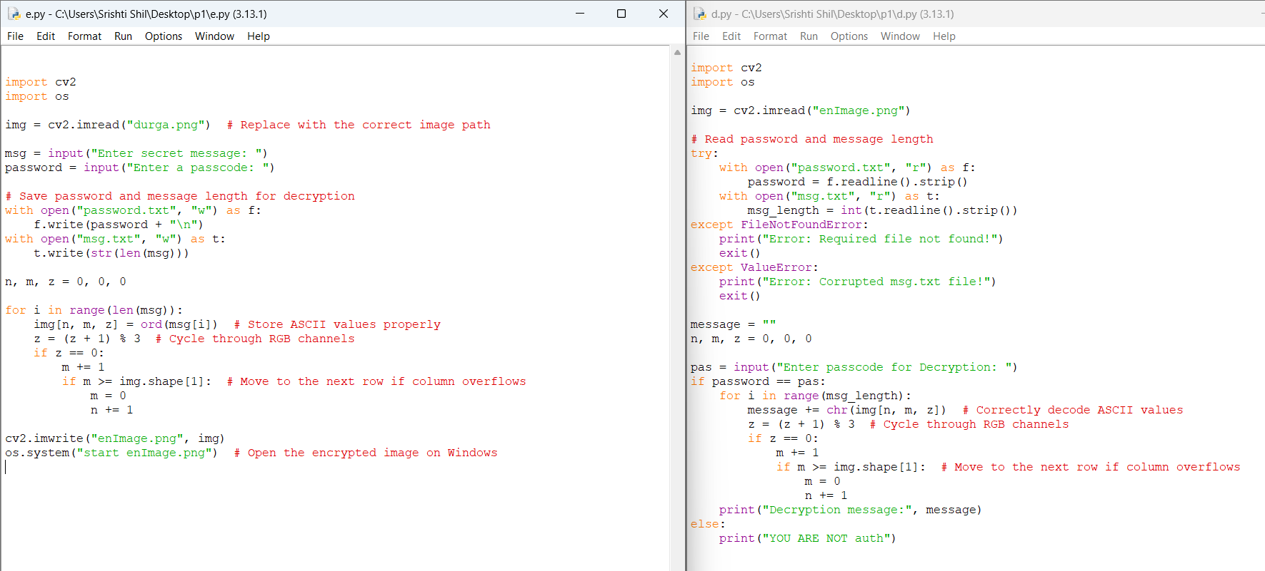
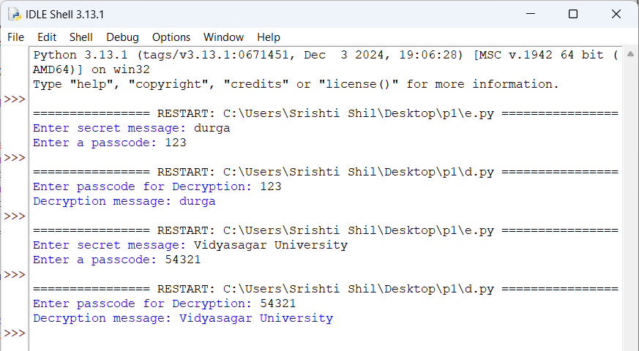
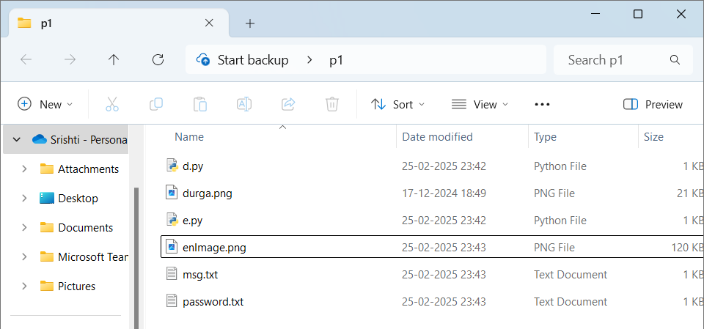
Results
Code:
Output:
Output files:

Slide 9
Conclusion
This project successfully demonstrates the use of image steganography for secure data hiding, ensuring covert communication while maintaining image integrity. By embedding secret messages within pixel values and implementing password-protected decryption, the system enhances data security and prevents unauthorized access. The approach is lightweight, efficient, and applicable across various fields, including cybersecurity, military intelligence, and secure financial transactions. With its minimal resource requirements and robust encryption potential, this technique provides a reliable solution for protecting sensitive information in digital communication.

Slide 10
GitHub Link
https://github.com/SrishtiShil/cypro.git

Slide 11
Future scope(optional)

Slide 12
THANK YOU

